Slide 1
New movie studio
The journey of setting-up this studio, started by exploring the following:
Top 250 best performing movies
Gross each movie generates in a year
Market research to understand the target audience
Marketing strategies from the movie ratings.

Slide 2
Top 250 best performing movies
To get these movies, IMDb website was scrapped and the data was downloaded in a csv file for easy data cleaning and exploration.
During the process of getting the data some information like the gross generated in an year got lost and this prompted to use html to get the data .
Below are some of the links which can redirect to the above data:
https://www.imdb.com/search/title/?groups=top_250&sort=user_rating
IMD1.csv

Slide 3
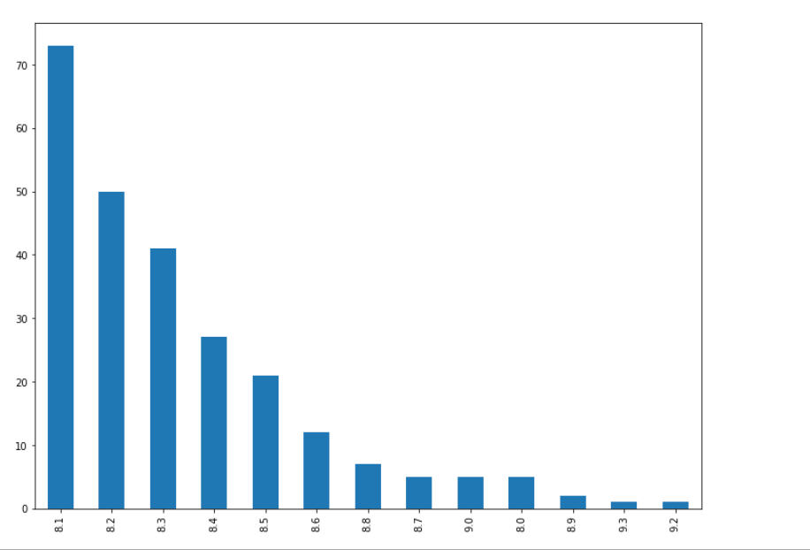
Gross each movie generates in a year
From the analysis conducted, it was clear that those movies with higher ratings ended up having low Gross generation since these movies were not largely watched.
While for the large population of movies, it turned out the rating was low but watched by most people as shown in the graph below.
From this presentation, when used for a decision making, genre of the movie makes a great impact in what moves fast and what is slow.

Slide 4
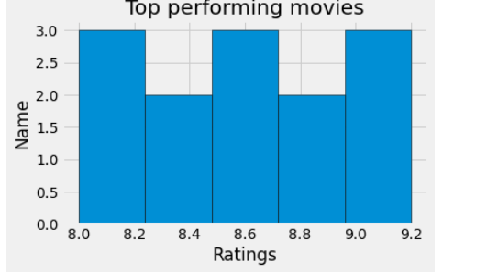
Market research to understand the target audience
From the above analysis, it is clear that the topmost movies turns out to have high ratings, regardless of the genre, the consumption of these movies is high and this can be used when the studio wants to restock because from the above data representation, these movies are fast moving.

Slide 5
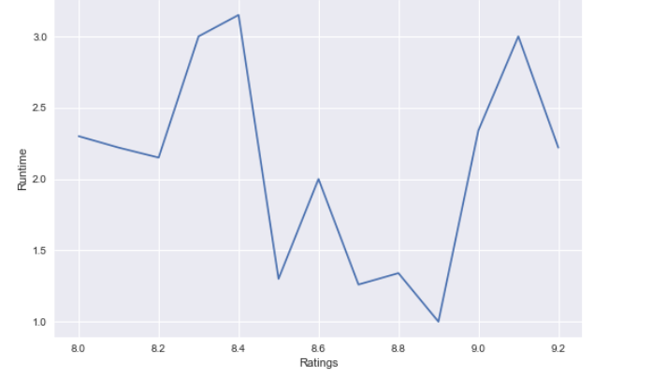
Marketing strategies from the movie ratings.
Runtime can be an insightful method which can be adopted to decide on the kind of movies to stock. From the above representation, the movies with high rating of 9.2 runs for 2 hrs, from the reviews, these movies don’t create suspense and that’s why in-terms of consumption not very many people watch them.
For the movies going for 2.5 to 3hrs,they seem to have low ratings but highly consumed since these movies are inform of series. These information can be useful since these kind of movies creates suspense and the moment the next series is released, the audience will be waiting to watch and therefore for a new movie studio it’s a chance to keep on restocking.

Slide 6
Recommendation
From the analysis conducted, a new movie studio has to do the following in order to be competitive in the market.
Analyze the data of best performing movies in the market.
Classify the movies into genres as this can affect the rating by audience
Check movie ratings versus their consumption to be able to determine which movies are fast moving and avoid having dead stock.
Analyze the Gross each genre of the movie generates, this information can help in deciding which varieties are highly consumed in the market.

Slide 7
Conclusion.
When conducting market research to get the data of the amount of revenue each movie generates in a year, there was a handle since these data seemed to be licensed and therefore for a new movie shop, Ratings can be a good starting point to decide on which movies will move fast depending with their audience.
There are audiences who download the movies to watch offline and don’t rate on the website, therefore, the consumption data can be used to make a decision on which movies are doing well even if the ratings do not match.

